Slide 1
I Have Decided to Become a Sikh
Goal of the Sikh faith

Slide 2
I have decided to become a Sikh.
At the Tri-State, Pittsburgh, USA camp, I gave a lecture regarding ‘Relevance of gurbani for the modern world’.
When I was coming out of the classroom, a senior student told me, “I have decided to become a Sikh”.
It was difficult for me to understand the meaning of her statement, because I knew her parents, who were devoted Sikhs.
Further, she herself behaved like a Sikh from all aspects; she kept uncut hair and she could recite gurbani.

Slide 3
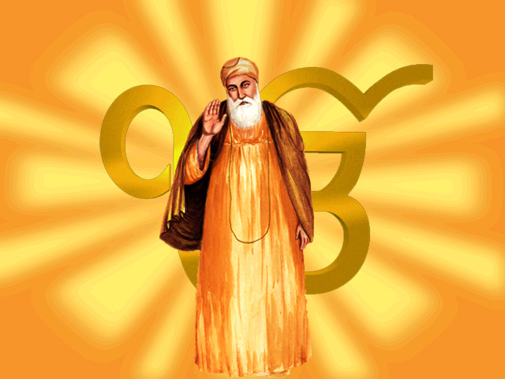
Goal fixed for the Panth by Guru Nanak
Without giving any response, I continued walking with her and thinking about what she intended to tell me.
After a brief silence, she completed her question, “Baba ji, I want to know the goal fixed for the Panth by Guru Nanak when he founded this faith.
What has the Panth done so far to achieve that goal?
And what is left to be done by me to achieve that objective so that I may be accepted as a Sikh

Slide 4
God! What a great Sikh she is.
Listening to it, I was immersed into a deep sea of thinking, “God! What a great Sikh she is.
How come I have spent my whole life without putting this challenging question to myself?”
The sincere words said by an innocent young Sikh shook me and awakened me to look inside myself. With me still drenched in these thoughts, we reached near the dining hall.
I responded, “God bless you.
We are proud of you young Sikhs who think on these lines.

Slide 5
Goal of the Sikh faith
"Define the goal of the Sikh faith for society and the religious path to be adopted by the Sikhs to realize that goal.“
Further, how the remaining mileage is to be covered (how the mission assigned to the Khalsa Panth is to be achieved) by the present generation, was an equally complex question.
Sikhs should not have forgotten their goal as a community, and the Panth should have addressed themselves to find an answer to that question.

Slide 6
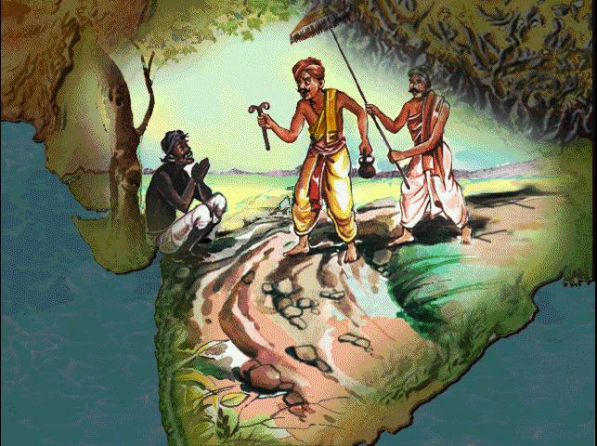
Bhai Gurdas explains that humanity lived in peace,
A Land divided by Religion ….
Bhai Gurdas, in his poetic style, then states that the earth was unable to bear the ‘weight’ of sins committed due to mutual hatred among the people and the practice of falsehood everywhere.
The earth, therefore, begged God to send a savior, and God deputed Guru Nanak for this job.
This defines the mission of Guru Nanak
Later it got into trouble by splitting itself into high and low castes; further divided into many faiths

Slide 7
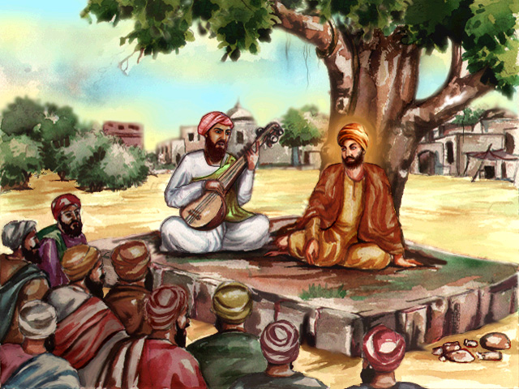
Mission assigned by God to Guru Nanak
(to unite the split humanity, teach people to give up hatred and practice mutual love)
“The contributions of the Gurus are well known to all of us The message of the sermon for us is not to divide society into different creeds, castes because they are all man-made differences.
God creates us equal; no one is inferior or superior; no one is alien, we are one big family having our common Mother-Father, God.
One can, now, understand the background and the great significance of the first sermon of Guru Nanak - “no one is a Hindu and no one is a Muslim

Slide 8
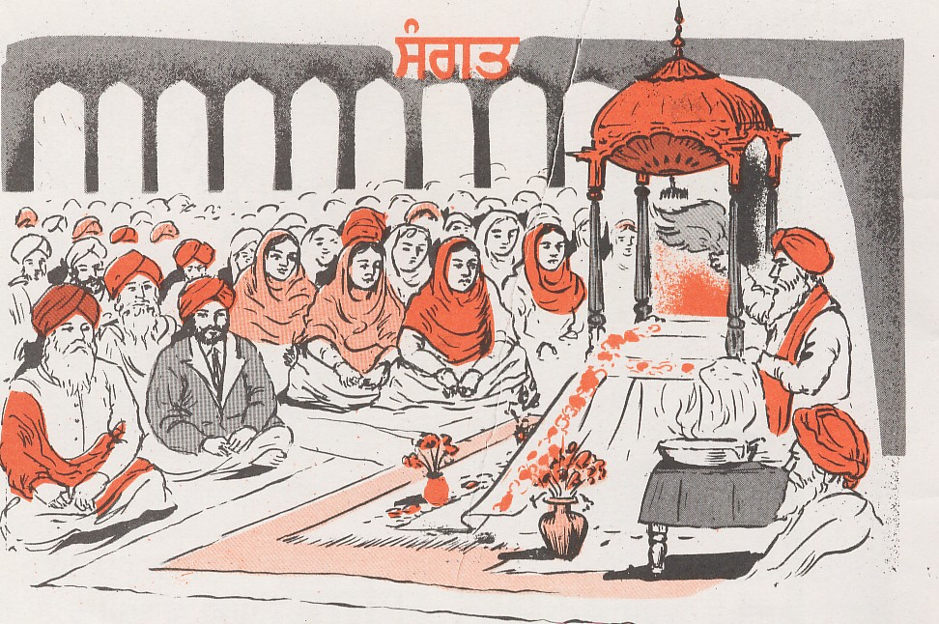
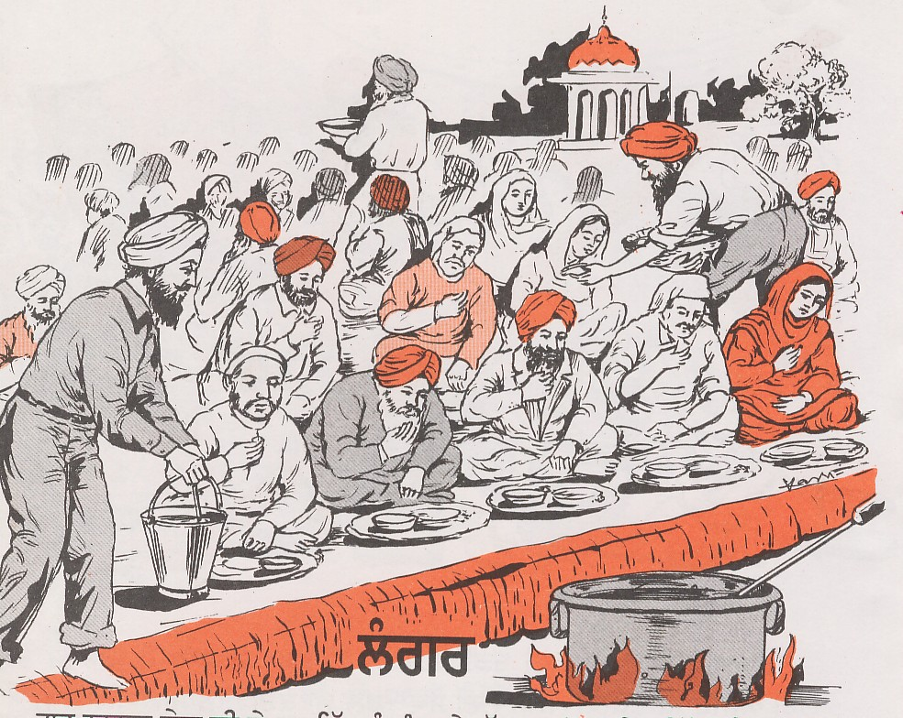
To remove our attitude of feeling inferior, superior
The institutions (sangat, pangat, common baoli, common sarovar, and common gurbani) that were introduced by the Gurus and made popular to remove our attitude of feeling inferior, superior, or different from other people.
This defines the goal intended by the Gurus to be achieved through these institutions.
sangat
pangat

Slide 9
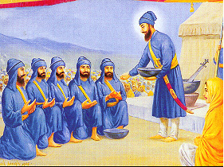
saint-soldiers -Legions of the Lord of Peace
All people were welcome to drink amrit from the same bowl and live as equals in every respect.
They were accepted as the spiritual sons and daughters of Guru Gobind Singh and Mata Sahib Kaur.
The duty assigned to the Khalsa– to protect human rights of the weak, uproot tyranny, and preach truth.
Finally, there is the founding of the institution of the Khalsa, when people were urged by the Guru to give up their differences because of their previous faith (dharm), caste (kul) etc

Slide 10
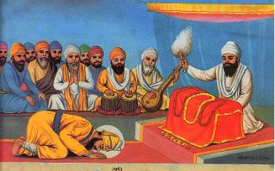
Tenth Nanak passed on the responsibility of the Guruship to the Khalsa
, "We find that Guru Nanak was deputed by God to unite the split humanity and create mutual regards among the people.
It was achieved during the Guru-period.
To continue to spread this message, to maintain peace and serve society, the tenth Nanak passed on the responsibility of the Guruship to the Khalsa.
GURGADI AT NANDED

Slide 11
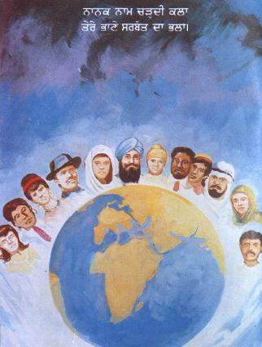
The mission of Nanak, thus, is an ongoing process.
We have to convince people that they are equal members of the large family, we call humanity.
It is for us to see what we can do to convey this message to every human being keeping in mind the religious, social, and political beliefs of the people.
Hating anyone or considering a person inferior is a sin.
This is the message of Nanak for maintaining peace in the world."
Daily prayer of sikhs
Welfare of whole humanity

Slide 12
, “Dear youth, we see that this is an ongoing assignment given to us.
You are welcome to discuss this issue to decide your duties/responsibilities during your life to help achieve the mission laid out by the Gurus.
Now it is up to you to define what you should do, and what you can do, to maintain love and peace among the people.”

